Slide 1
SIT323 Cloud Application Development
Class 1 – Introduction
SIT323 - Deakin University - 2018
Page 1

Slide 2
Contents
Unit Contacts
About this unit
Unit Format
Class Topics
Practicals
Assessment Tasks
Unit Site Resources
Readings
Expectations
Practical Expectations
Theme for 2018
Assessments – In Brief
Complexity of Assessments
Plagiarism and Collusion
Where to from here?
Questions
SIT323 - Deakin University - 2018
Page 2

Slide 3
Unit Contacts
Geelong and Cloud (online)
Dr Robert Dew (Unit chair)
rad@deakin.edu.au
Burwood
Dr Kevin Lee
kevin.lee@deakin.edu.au
SIT323 - Deakin University - 2018
Page 3

Slide 4
About This Unit
This unit is about
cloud application development
code testing
code standards
using an IDE, libraries, APIs and other coding resources
extending your software development portfolio
SIT323 - Deakin University - 2018
Page 4

Slide 5
Unit Format
10 classes
10 practicals
2 assessment tasks
No examination
Blackboard Collaborate sessions for Cloud (online) students – details TBA
SIT323 - Deakin University - 2018
Page 5

Slide 6
Class Topics
Introduction
Data Validation
Assertions and Unit Testing
Conventions
Optimisation Algorithms
Cloud Applications
Cloud Applications
Cloud Applications
Coupling and Writing Good Interfaces
Cohesion
SIT323 - Deakin University - 2018
Page 6

Slide 7
Practicals
Practicals will be run like workshops, these will
Move you towards developing your application
Help you develop and use unit tests
Refresh your coding skills
Refresh your IDE skills
Help you conform to coding standards
Develop your portfolio
SIT323 - Deakin University - 2018
Page 7

Slide 8
Assessment Tasks
Two programming tasks (40%, 60%)
Task 1: validate puzzle files load, display, and validate a puzzle
Task 2: load puzzle requirements from files create a cloud application to create a puzzle compute the score of a puzzle save a puzzle
Together, these will help you increase your software portfolio
SIT323 - Deakin University - 2018
Page 8

Slide 9
Unit Site Resources
Resources are organised into 5 main folders
Unit Information
Unit Guide, Weekly Timetable, …
Assessment
Programming Task 1 and 2
Weekly Resources
Class slides, Practicals
Echo System
Class recordings from Burwood, Melbourne and Waurn Ponds, Geelong
Bb Collaborate
Online sessions for Cloud students, organised and run by Robert
SIT323 - Deakin University - 2018
Page 9

Slide 10
Readings
No prescribed textbooks
Recommended readings
Available as PDF, links, etc., on the unit site
Updated progressively
SIT323 - Deakin University - 2018
Page 10

Slide 11
Expectations
This unit is not about teaching a programming language
MS Visual Studio and C# will be used by all campus and cloud (online) students
All students will work in pairs.
programmer and a programmer Permitted
non-programmer and a programmer Permitted
non-programmer and non-programmer NOT Permitted
SIT323 - Deakin University - 2018
Page 11

Slide 12
Expectations
Development will be challenging
As runtimes dramatically increase with more constraints, it will be difficult and time consuming to detect and fix bugs
Testing will become very important
SIT323 - Deakin University - 2018
Page 12

Slide 13
Practical Expectations
All students should complete practicals as these are tightly integrated with assessment tasks
Cloud (online) students
You are welcome to join any workshops at B or G
Practical times available at http://www.deakin.edu.au/timetable
SIT323 - Deakin University - 2018
Page 13

Slide 14
Practical Expectations
Your practical exercises are elements that assist you in completing your assignments
There will be a lot of:
independent learning, and
self-direction
SIT323 - Deakin University - 2018
Page 14

Slide 15
Theme for 2018 – Word Games/Puzzles
Some word games and puzzles are:
Scrabble
Word search
Crossword
Crozzle
SIT323 - Deakin University - 2018
Page 15

Slide 16
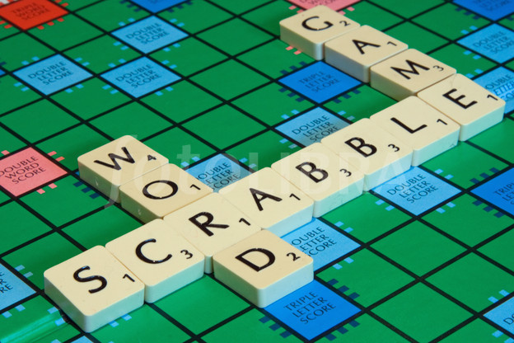
Theme for 2018 – Word Games/Puzzles
Scrabble
SIT323 - Deakin University - 2018
Page 16

Slide 17
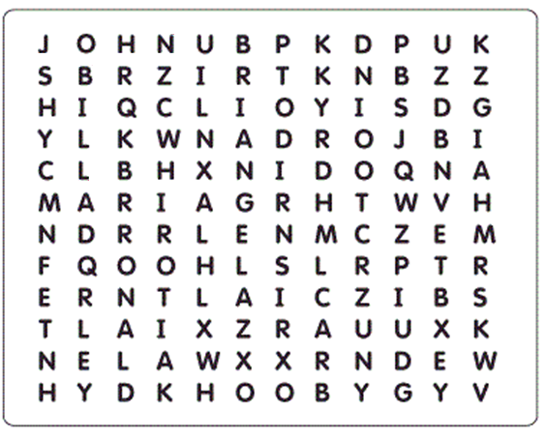
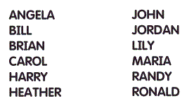
Theme for 2018 – Word Games/Puzzles
Word search
SIT323 - Deakin University - 2018
Page 17

Slide 18
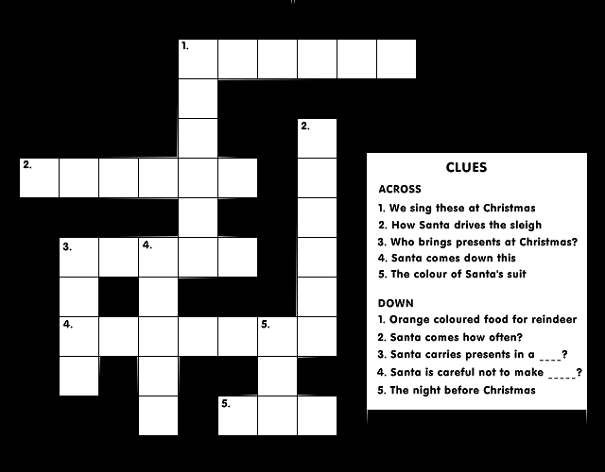
Theme for 2018 – Word Games/Puzzles
Crossword
C A R O L S
C
A
R
R
O
T
SIT323 - Deakin University - 2018
Page 18

Slide 19
Theme for 2018 – Word Games/Puzzles
Crozzle
ALE BATH HE ME MAST MATADOOR
MILK PATCH PEARL RENT ROOM SCALP
SPEAR SHE TEA WATER WET
S P E A R
P
A
T
H
E
A
R
L
O
O
M
M T D O R
W A E
E
N
T
S C A P
B A T
W E
SIT323 - Deakin University - 2018
Page 19

Slide 20
Theme for 2018 – Word Games/Puzzles
Crozzle
Start with an empty grid and a list of words
Place a sub-list of words onto the grid, in a crossword like fashion, to achieve a high score such as:
Each word scores points
Each intersection of two words scores points
SIT323 - Deakin University - 2018
Page 20

Slide 21
Theme for 2018 – Word Games/Puzzles
Scoring Example
Each word is worth 10 points
Intersections:
Each vowel is worth 1 point
Letters from B to M are worth 5 points
Letters from N to Z are worth 20 points
SIT323 - Deakin University - 2018
Page 21

Slide 22
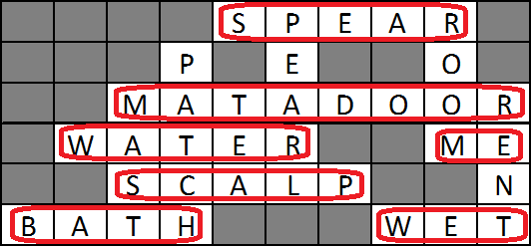
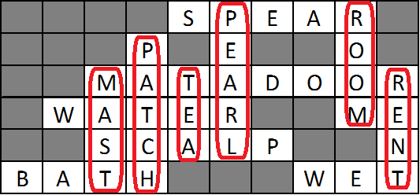
Theme for 2018 – Word Games/Puzzles
Scoring Example
7 horizontal words = 70 points
6 vertical words = 60 points
SIT323 - Deakin University - 2018
Page 22

Slide 23
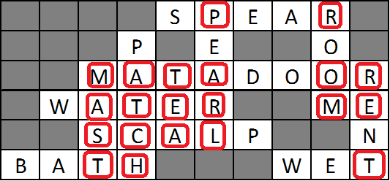
Theme for 2018 – Word Games/Puzzles
Scoring Example
Intersections:
7 vowels = 7 points
5 letters B-M = 25 points
9 letters N-Z = 180 points
Total Score = 70 + 60 + 7 + 25 + 180 = 342
SIT323 - Deakin University - 2018
Page 23

Slide 24
Theme for 2018 – Word Games/Puzzles
Why is the following crozzle invalid?
MARYX is not in the list
JO is not in the list
ADA | MARY
ADAM | NEYMAR
AL | REX
ALEX | ROXY
ALF | ROY
ELMO | ZENA
JODY | ZORBA
Z | O | R | B | A
E |  | O |  | D
N | E | Y | M | A | R
A | L |  |  |  | O
 | M | A | R | Y | X
J | O |  |  |  | Y
SIT323 - Deakin University - 2018
Page 24

Slide 25
Assessment Task 1 – In Brief
In general, design and develop:
unit tests to evaluate your application
an application to validate and process 3 crozzle files (czl, cfg, seq)
The projects in your Visual Studio solution must be able to:
Run unit tests
Load crozzle information from files
Display a crozzle
Validate files and crozzles
Log issues
SIT323 - Deakin University - 2018
Page 25

Slide 26
Assessment Task 2 – In Brief
In general, design and develop:
unit tests to evaluate your application
a cloud application to automatically create a crozzle, based on any list of words
The projects in your Visual Studio solution must be able to:
Run unit tests
Load crozzle information from files
Create a high scoring crozzle
Compute the score of a crozzle
Save a crozzle to a file
SIT323 - Deakin University - 2018
Page 26

Slide 27
Complexity of Assessments
The above sounds easy when no constraints are applied.
For example, placing 2 short words into a grid of size 10 by 10 is far too simple for a third year programming student.
Q - What is a simple solution that makes this problem easy to solve?
A - Use the same word twice, clearly there will be a common letter for an intersection.
SIT323 - Deakin University - 2018
Page 27

Slide 28
Complexity of Assessments
Let’s increase the complexity by adding some constraints such as:
grid size is 10 by 10
each word must cross at most 2 other words
include at least 2 horizontal and 2 vertical words
Q - Even with these constraints, what can be a basic solution.
A - Create a stair case pattern.
 |  |  |  |  |  |  |  |  | I
 |  |  |  |  |  |  | C | O | T
 |  |  |  |  |  |  | A
 |  |  |  |  | S | A | T
 |  |  |  |  | O
 |  |  | D | E | N
 |  |  | A
 | B | I | D
 | A
A | T
SIT323 - Deakin University - 2018
Page 28

Slide 29
Complexity of Assessments
Let’s further increase the complexity:
grid size is 10 by 10
words cannot be repeated
words contain 5 or more characters
include 5 horizontal words and 5 vertical words
Q - Is a solution possible?
A - You’ll need to rely on computer science skills to solve this problem.
SIT323 - Deakin University - 2018
Page 29

Slide 30
Complexity of Assessments
Let’s further increase the complexity:
grid size is 10 by 10
list of 1000 words, and words cannot be repeated
each word can cross many other words
each sequence of 2 or more characters must form a word from the given word list
compute the maximum score
Q - Is a solution possible?
SIT323 - Deakin University - 2018
Page 30

Slide 31
Complexity of Assessments
Let’s consider the time for a brute force solution.
Grid size = 10 x 10, so we have 100 grid elements
Each grid element can contain one of 27 items (26 letters, plus it can be empty).
The number of combinations is 27₁ x 27₂ x 27₃ x … x 27₁₀₀ = 27¹⁰⁰ = 1.369 x 10¹⁴³
At 1 micro second per combination, it takes about
4.34 x 10¹²⁹ years
SIT323 - Deakin University - 2018
Page 31

Slide 32
Complexity of Assessments
During previous versions of SIT323, each student created a solution that executed on one machine. A few students attempted threads.
This year, 2018, your solution will be cloud based by using:
more than one VM to help solve the puzzle
a load balancer
a scaling group
SIT323 - Deakin University - 2018
Page 32

Slide 33
Plagiarism and Collusion
Ensure you understand what these are.
If you are penalised due to this, you effectively fail the unit.
If you are unsure, ask!
SIT323 - Deakin University - 2018
Page 33

Slide 34
Where to from here?
Download the ‘Unit guide’ from the unit site.
Download the ‘ULO Percentages and Final Results’.
Practicals starts next week (Week 2).
Start Assessment Task 1 now.
Do not start a few days before the due date as you will not have time.
Start thinking about Task 2.
SIT323 - Deakin University - 2018
Page 34

Slide 35
Questions
See you next week!
SIT323 - Deakin University - 2018
Page 35

